Slide 1




Design of Two Payloads and NDVI Analysis on a High-Altitude Balloon
Pima Community College ASCEND Team
Students: William Carroll, Brittney Marimow, Andrew Okonya, Joel Thibault
Mentor: Mike Sampogna, Physics Dept., Pima Community College Northwest
Space Grant Symposium in Tucson, Arizona on April 16th, 2016
Notes:
1 minute per slide means 7 slides

Slide 2
Abstract
Two payloads were built to encompass multiple experiments.
The first payload was built with a printed circuit board and a feather data-logger which significantly minimized the size of the payload.
The second payload contained an Attitude and Heading Reference System (AHRS) and three Mobius cameras.
Use of a modified Mobius plant camera, by Public Lab, for NDVI photos.
Use of an AHRS to discern the orientation of the payload and the strength of the Earth’s magnetic field

Slide 3
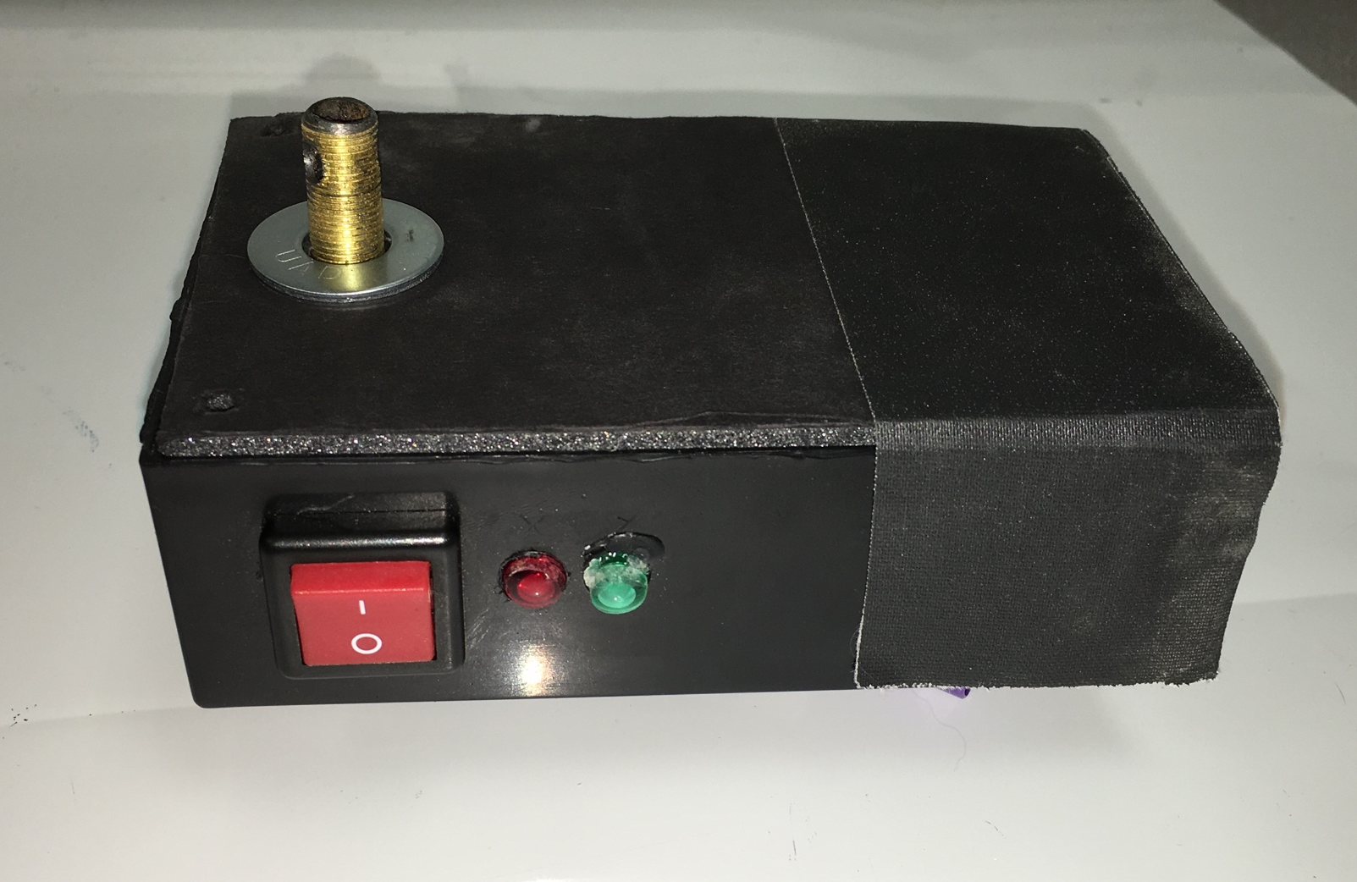
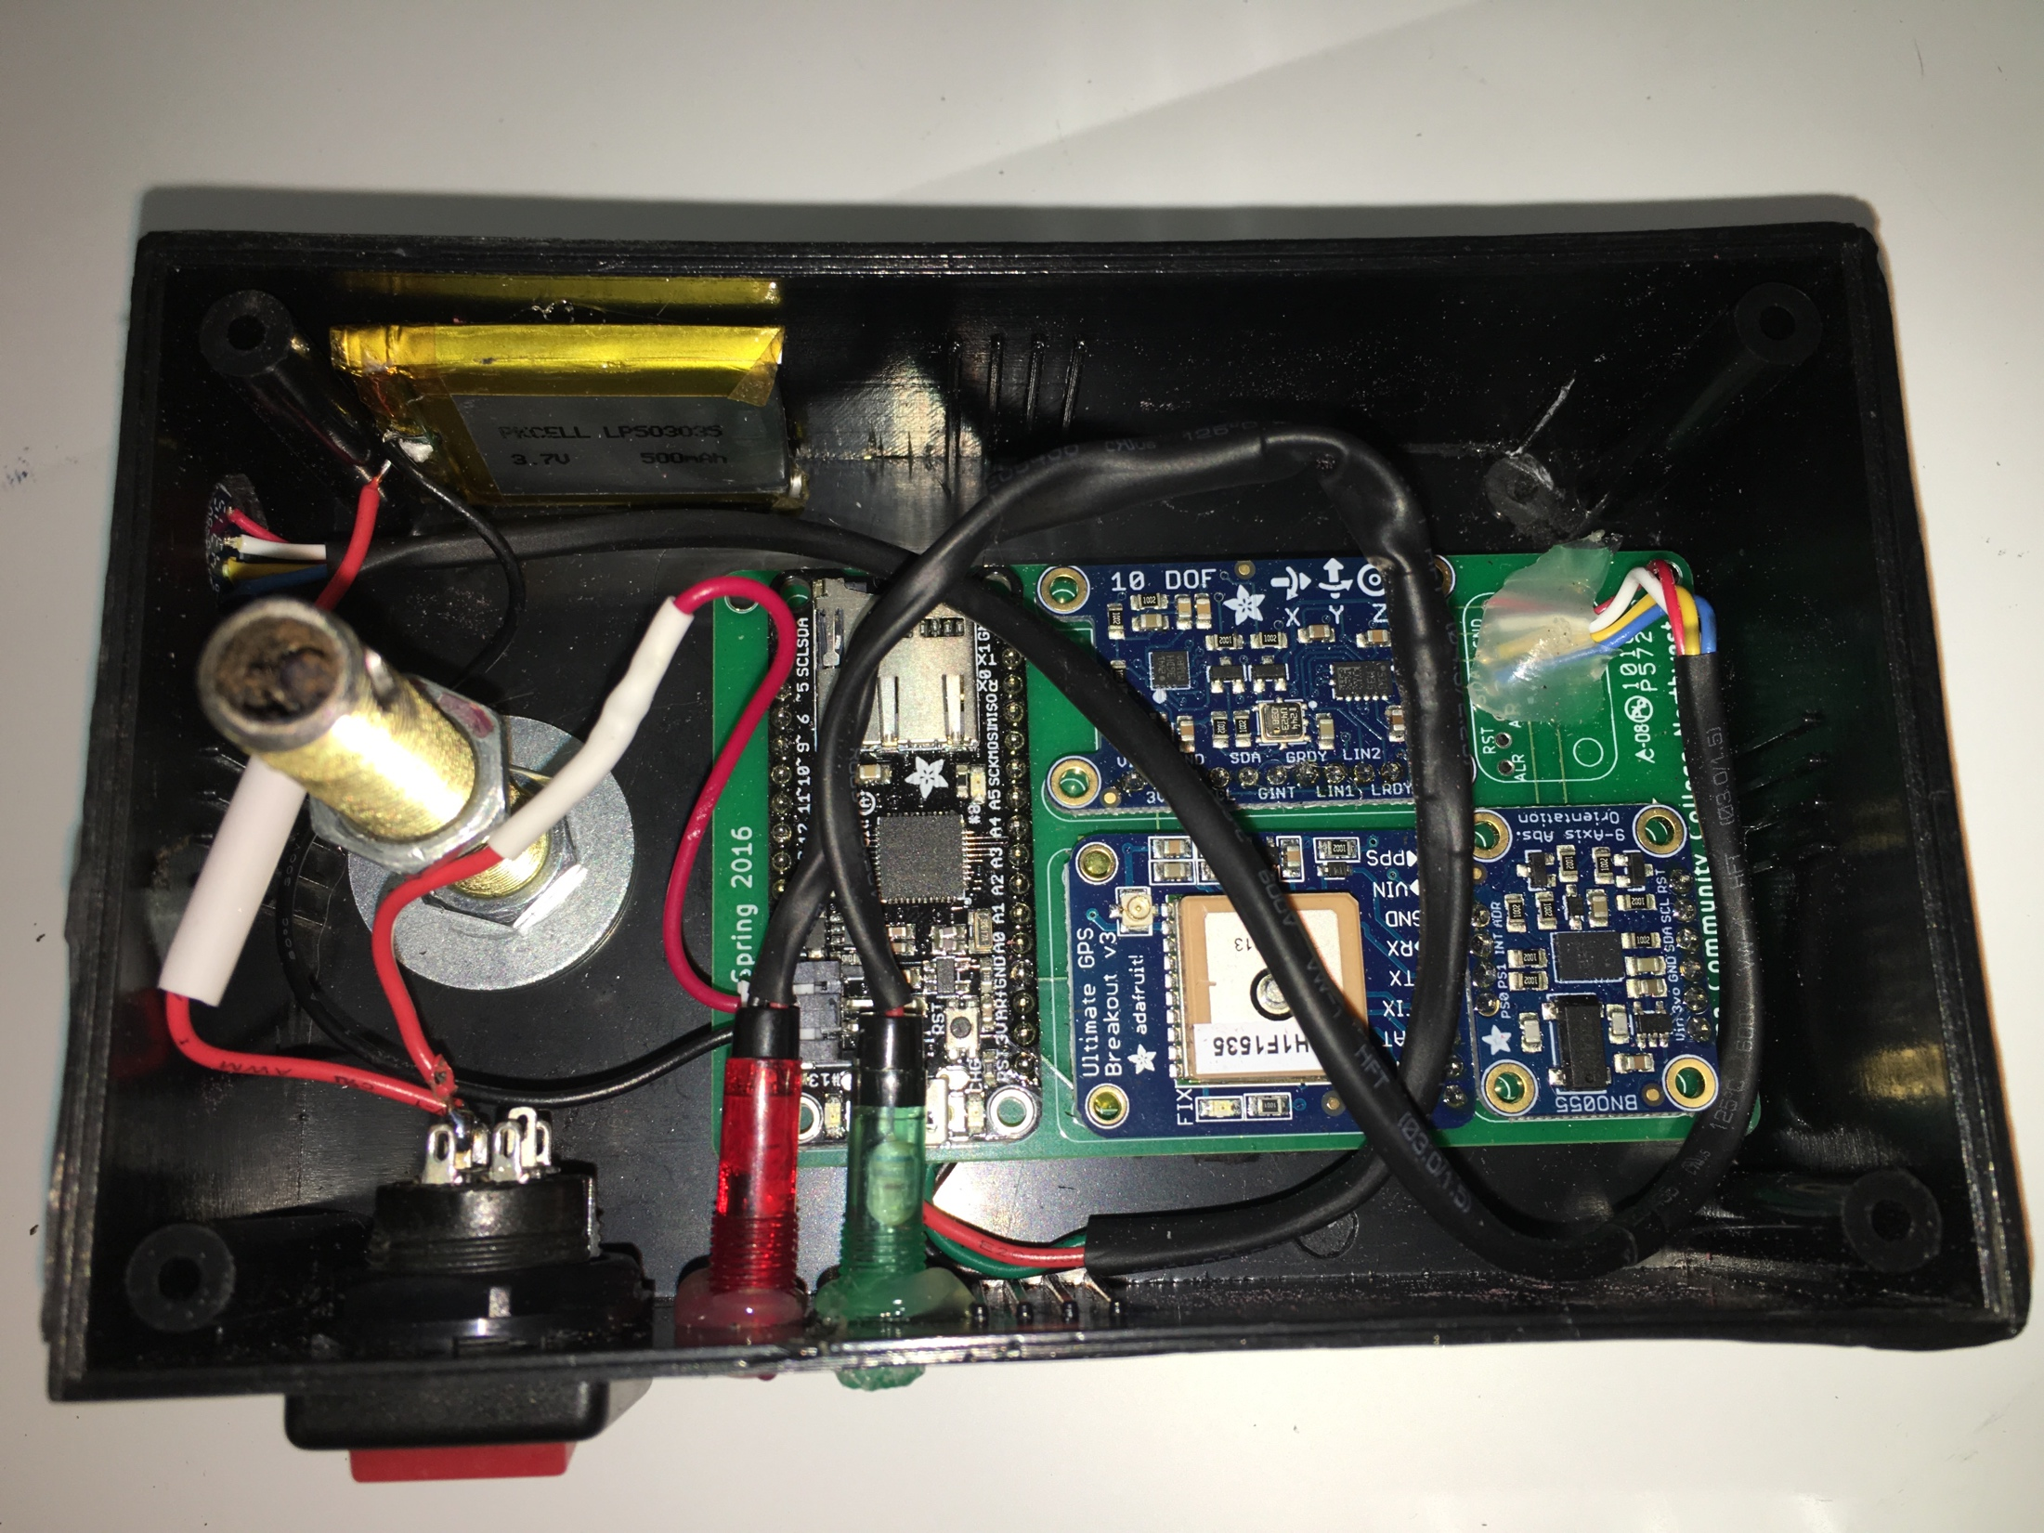
Payloads
Notes:
How did you transition to this slide from the last one?????

Slide 4
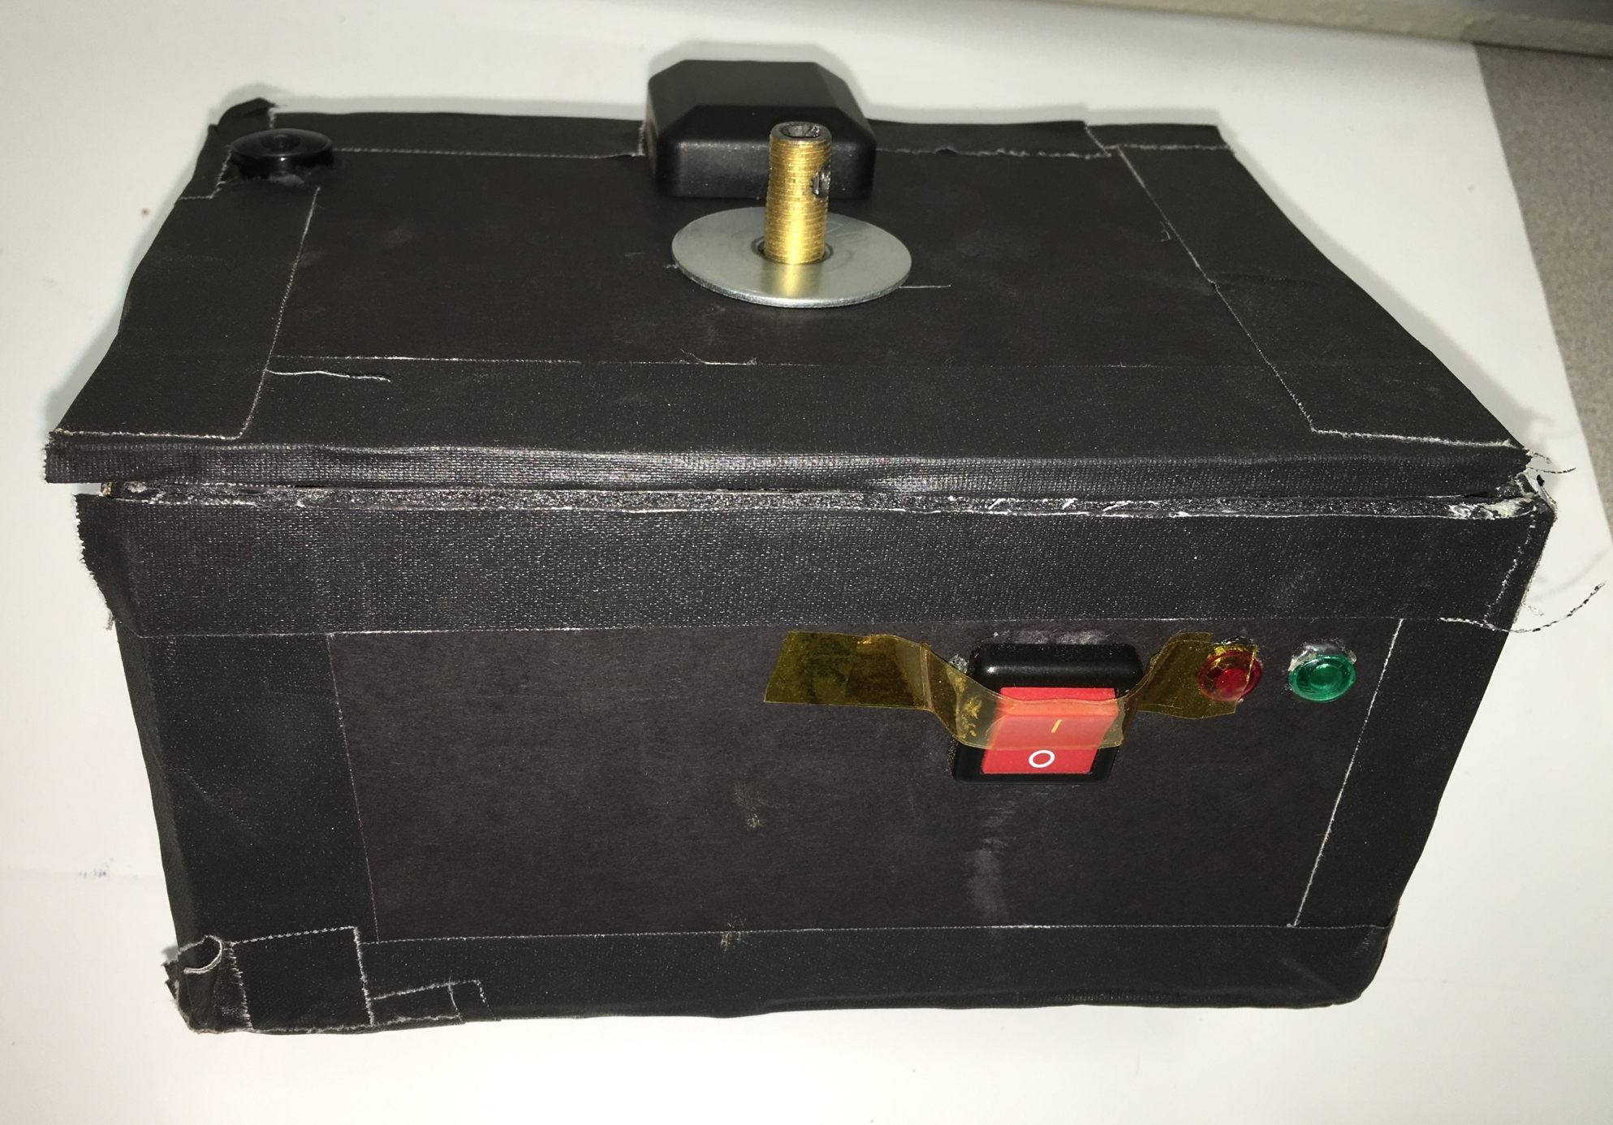
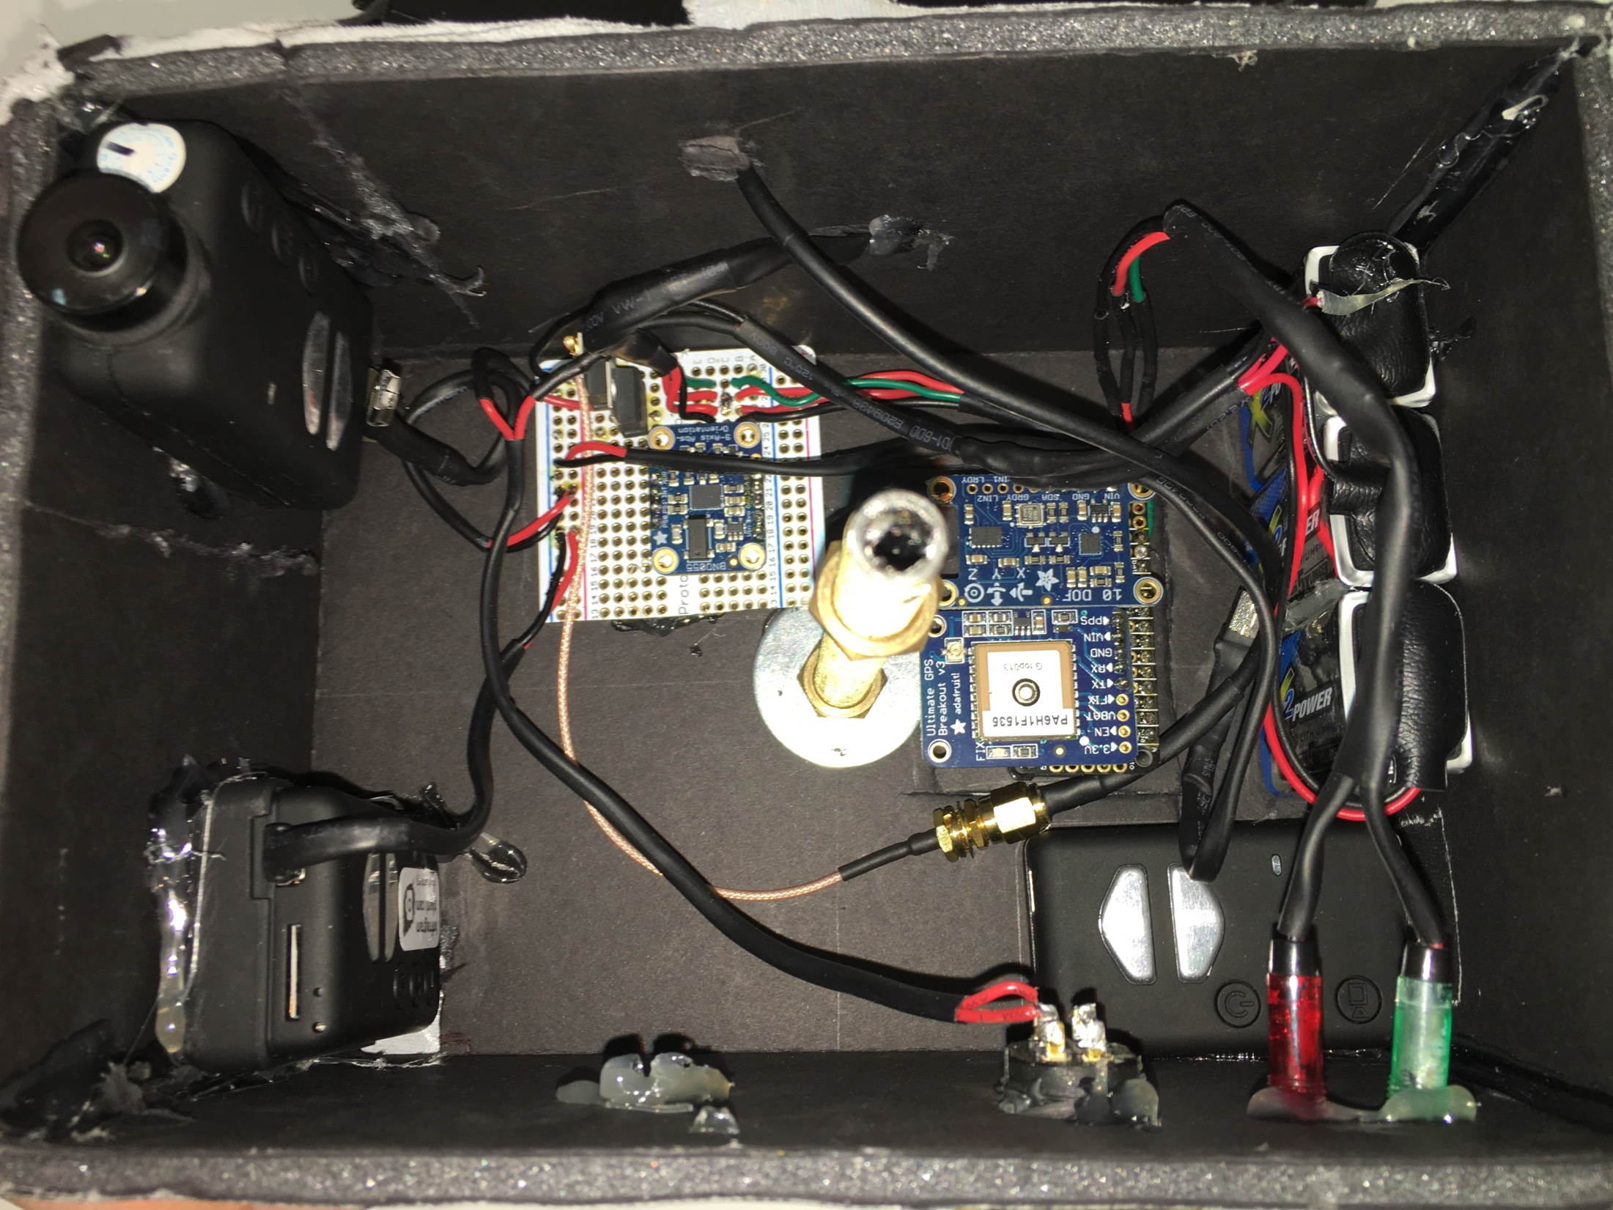
Payloads
Notes:
How did you transition to this slide from the last one?????

Slide 5
Electronics Overview
Fall 2015
Component | Purpose/Experiment
Arduino Mega | Microcontroller
Arduino Mega Prototyping Shield | Wiring
Adafruit MicroSD Breakout | Data logging
Adafruit Ultimate GPS Breakout | Location, time, and elevation sensing
Adafruit 10-DOF IMU Breakout | Orientation, inertial, and magnetic sensing
Adafruit SI1145 UV/IR/Vis. Light Sensor | Light sensing
Adafruit BMP183 Pressure Sensor | Ambient condition sensing
DHT22 Temp/Humidity Sensor | Ambient condition sensing
TMP36 Temperature Sensor | Ambient condition sensing
Mobius Action Camera | Video recording
Raspberry Pi Model B+ | NDVI camera driver and video storage
Raspberry Pi Cam | NDVI camera

Slide 6
Electronics Overview
Spring 2016
Component | Purpose/Experiment
Adafruit Feather M0 | Microcontroller/Datalogger
Adafruit Ultimate GPS Breakout | Location, time, and elevation sensing
Adafruit 9-DOF True Orientation Sensor | Orientation, inertial, and magnetic sensing
Adafruit 10-DOF IMU Breakout | Orientation, inertial, and magnetic sensing
Adafruit SHT31D Temp/Humidity Sensor | Ambient condition sensing
Mobius ActionCam | Video recording
Modified Mobius ActionCam | NDVI recording
Reasoning for changes
  Improve microcontroller and sensor for magnetometry
  Minimize electromagnetic interference
  Improve NDVI capture

Slide 7
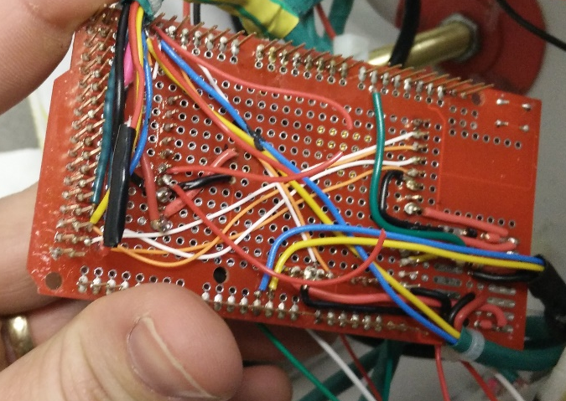
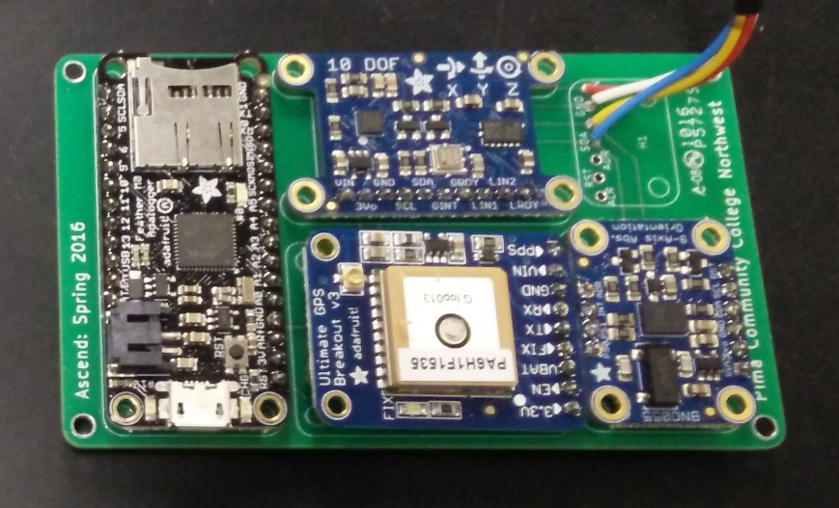
Electronics Overview
Fall 2015
Spring 2016

Slide 8
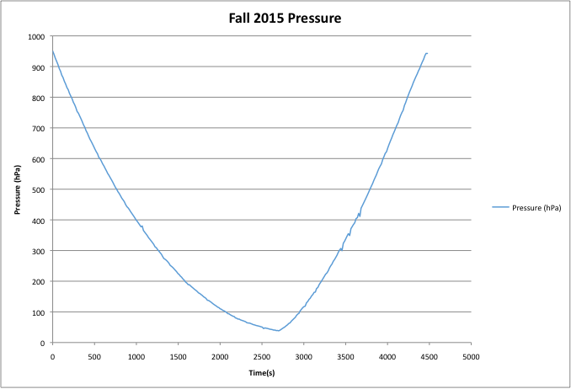
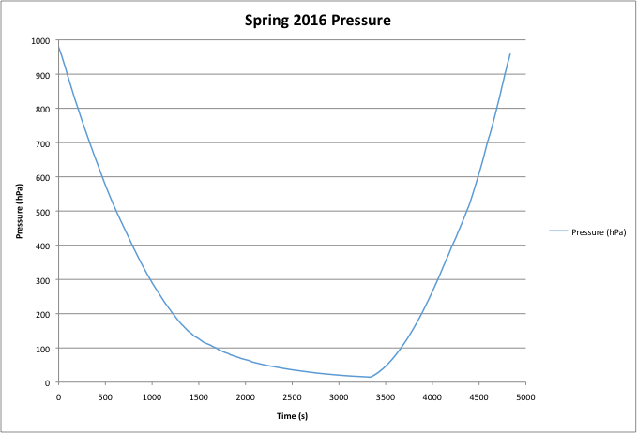
Data
Notes:
Changes:
Replaced previous figure with the IGRF expected values based on Jack’s data.
-kept it yellow for consistency…yellow is very hard to see..change color
Figure is highly linear and horizontal after considering the scale factors
How did you get values of mag filed strength?? From a calc? from data??? State where

Slide 9
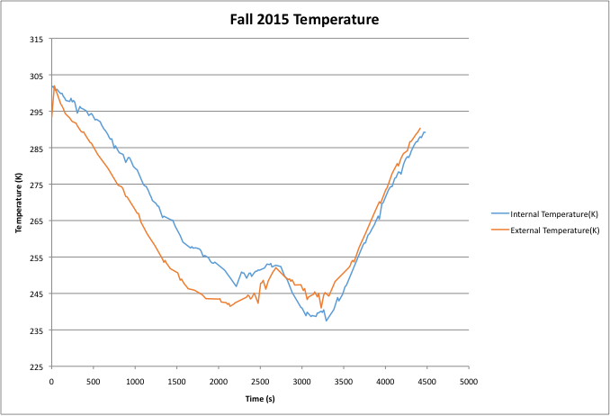
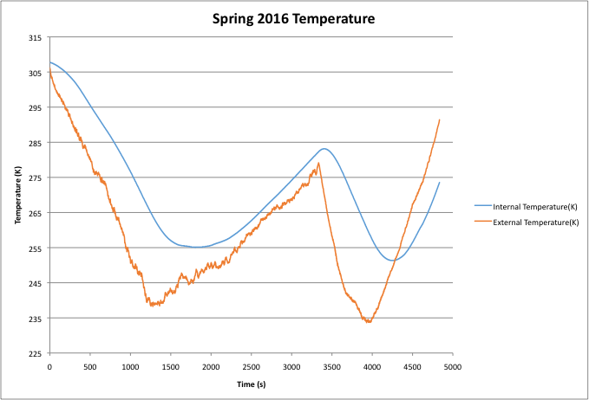
Data
Notes:
Changes:
Replaced previous figure with the IGRF expected values based on Jack’s data.
-kept it yellow for consistency…yellow is very hard to see..change color
Figure is highly linear and horizontal after considering the scale factors
How did you get values of mag filed strength?? From a calc? from data??? State where

Slide 10
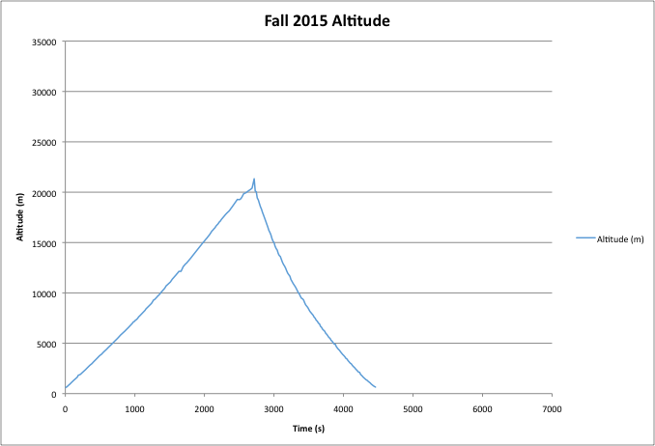
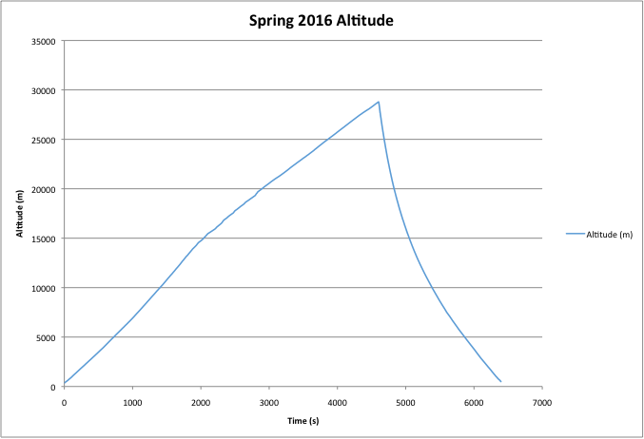
Data
Notes:
Changes:
Replaced previous figure with the IGRF expected values based on Jack’s data.
-kept it yellow for consistency…yellow is very hard to see..change color
Figure is highly linear and horizontal after considering the scale factors
How did you get values of mag filed strength?? From a calc? from data??? State where

Slide 11
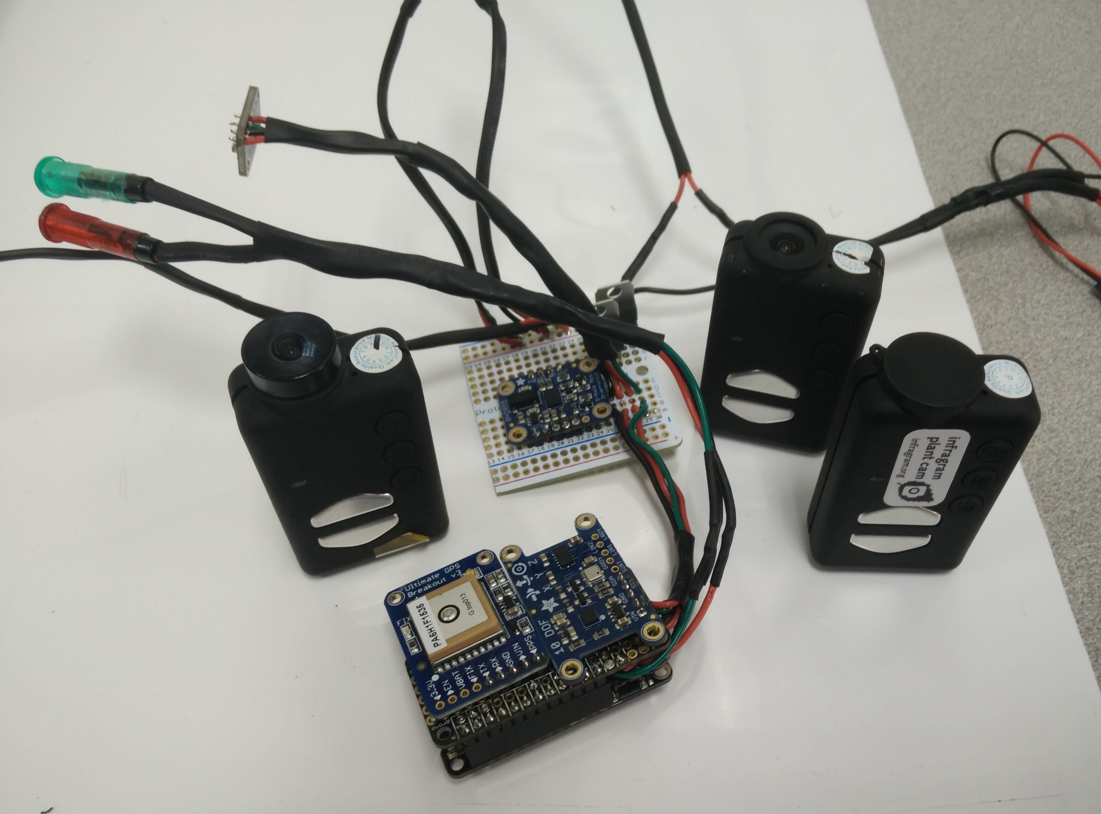
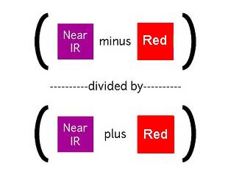
NDVI
  Payload objective: Record flight Images and observe vegetation using Normalized Difference Vegetation Index (NDVI)
  Mobius Action camera modified by Public Lab.
Notes:
Low pass filtering is the only one worth talking about. ( I can explain later)
Can we do an animation in this order?:
Raw unfiltered data
Filtered data
Filtered with best line fit
This sequence should grant us enough talking points to use all of our time.

Slide 12
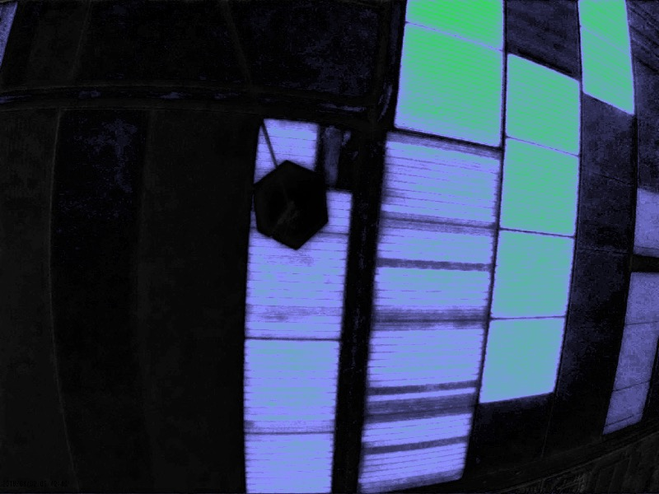
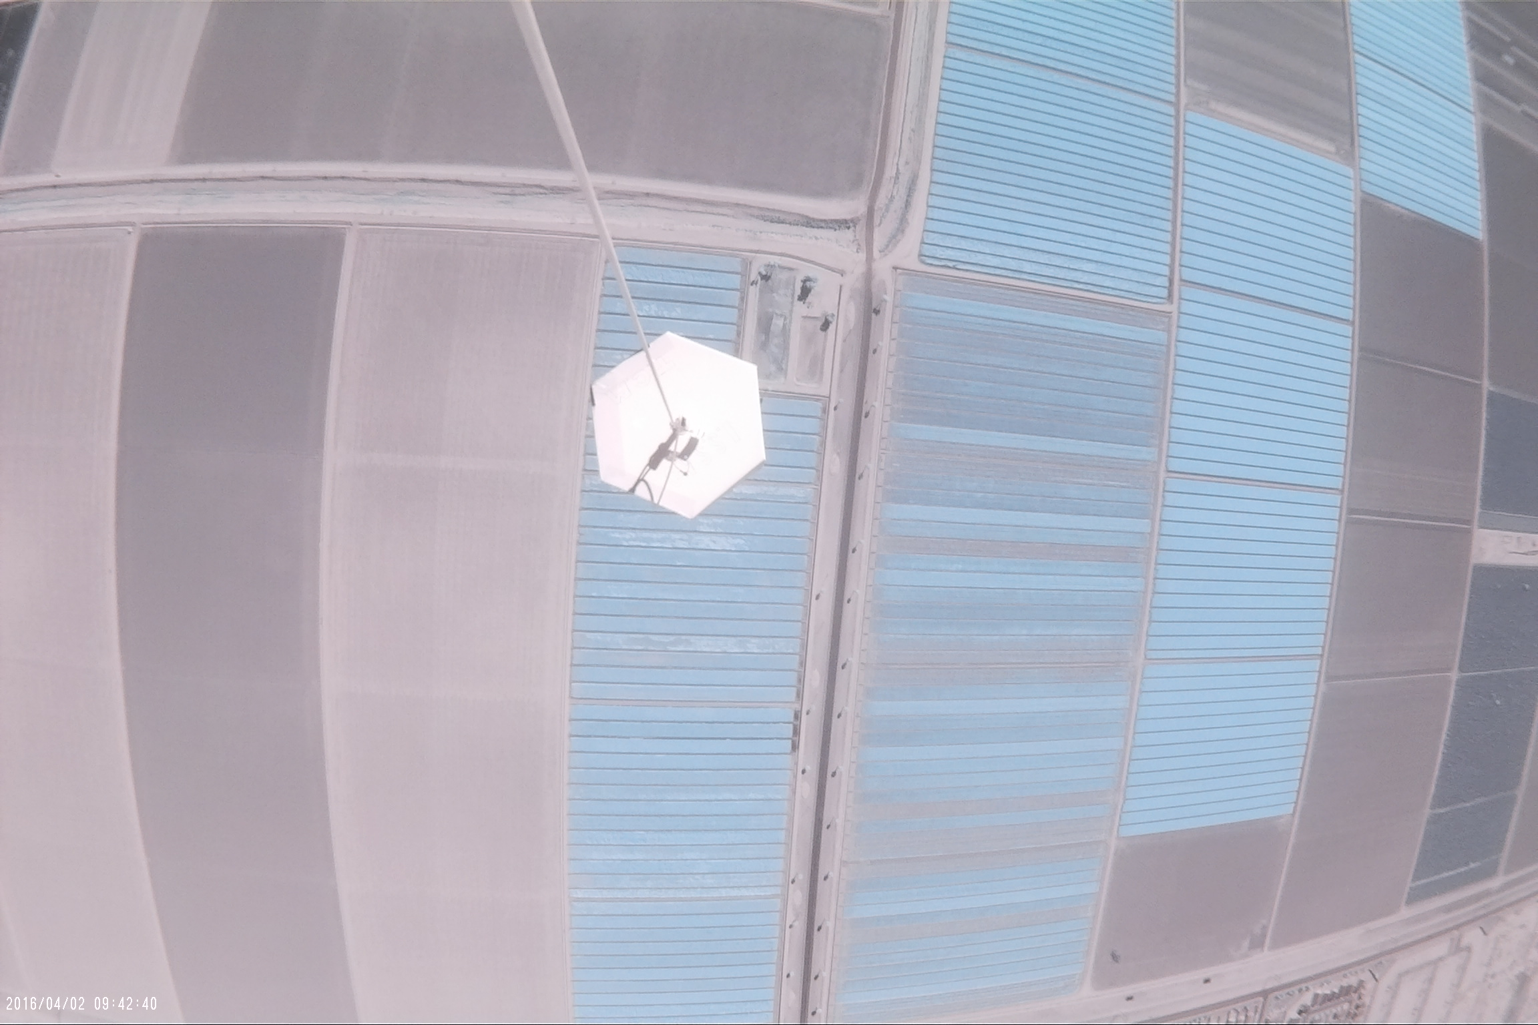
NDVI
9200 Ft.
Notes:
Low pass filtering is the only one worth talking about. ( I can explain later)
Can we do an animation in this order?:
Raw unfiltered data
Filtered data
Filtered with best line fit
This sequence should grant us enough talking points to use all of our time.

Slide 13
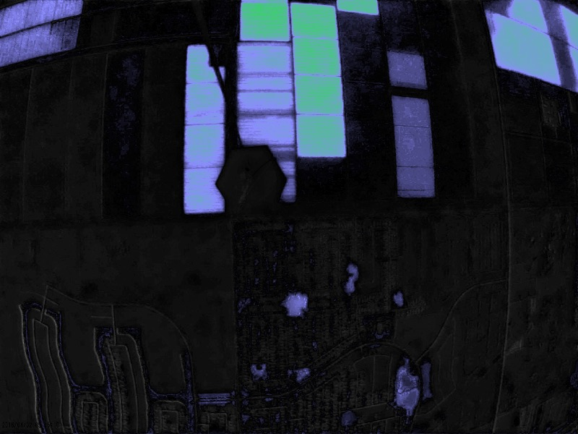
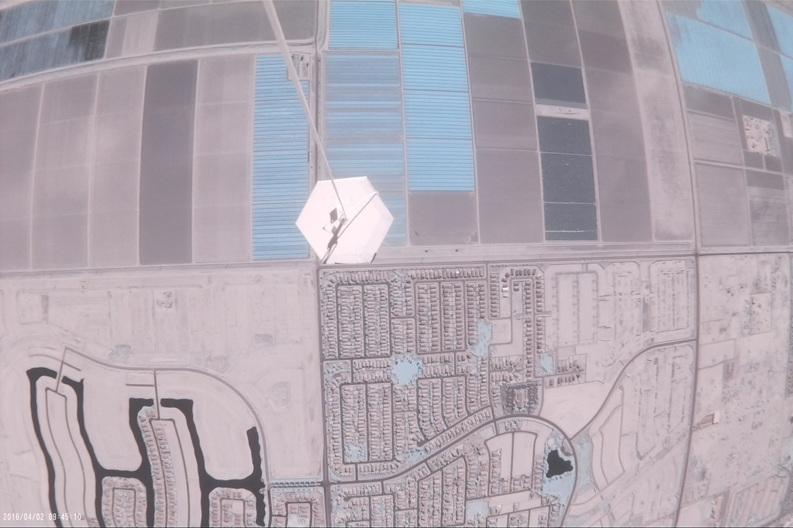
NDVI
13200 Ft
Notes:
Low pass filtering is the only one worth talking about. ( I can explain later)
Can we do an animation in this order?:
Raw unfiltered data
Filtered data
Filtered with best line fit
This sequence should grant us enough talking points to use all of our time.

Slide 14
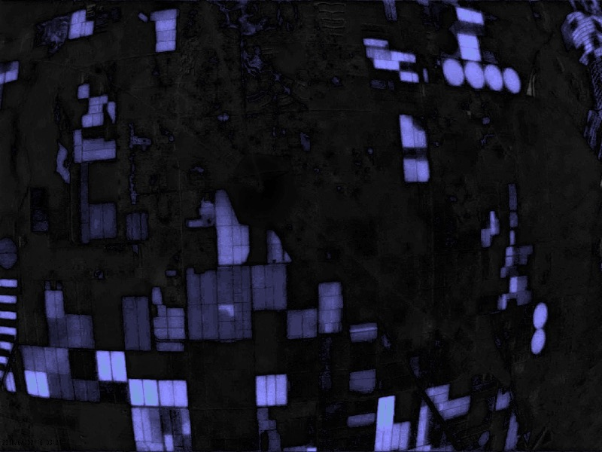
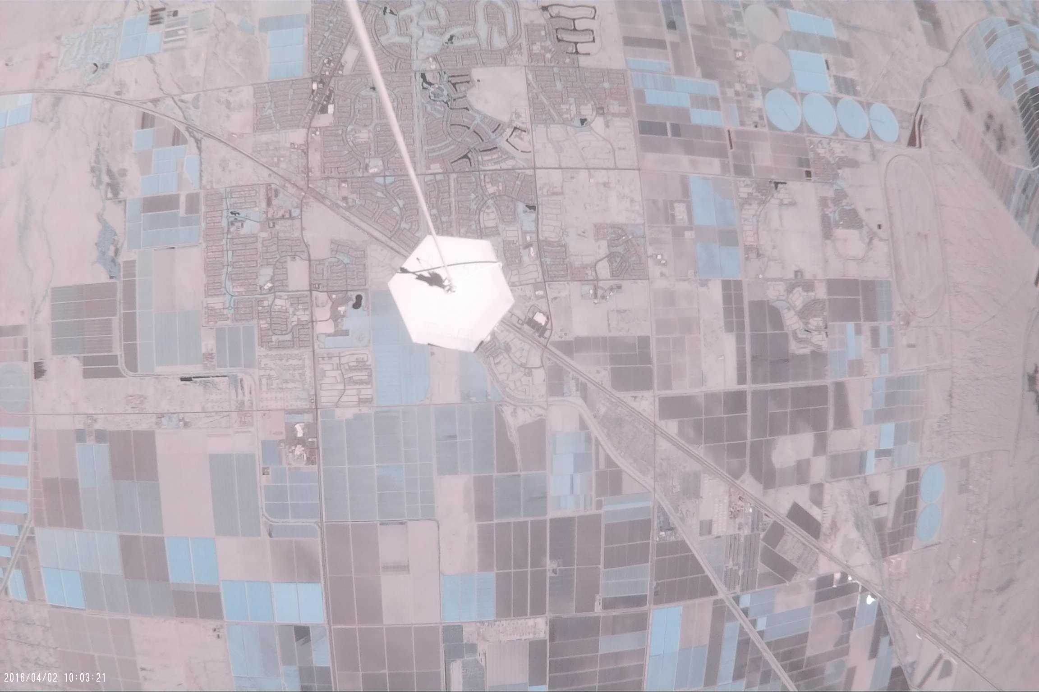
NDVI
37700 Ft.
Notes:
Low pass filtering is the only one worth talking about. ( I can explain later)
Can we do an animation in this order?:
Raw unfiltered data
Filtered data
Filtered with best line fit
This sequence should grant us enough talking points to use all of our time.

Slide 15
Conclusion
Successes
Limitations
Sensors used this semester were an improvement over last semester.
A much smaller payload with limited electromagnetic interference.
Use of a modified Mobius camera for better NDVI images.
The GPS data was not accurate and this affected the latitude, longitude, and altitude data
By the nature of the balloon there is no way to control what fields are imaged.

Slide 16
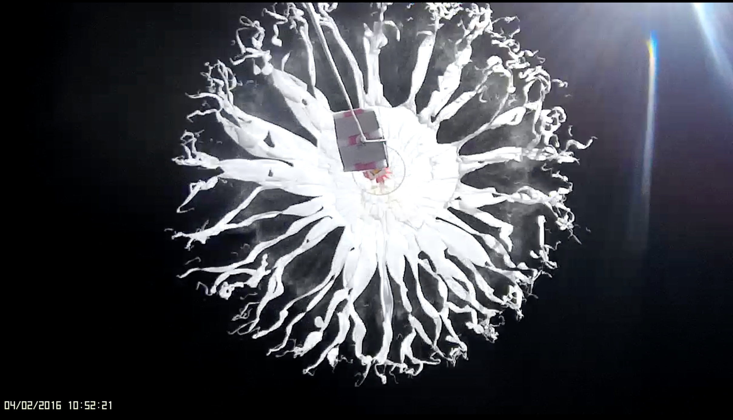
Thank you!
Questions?

Slide 17
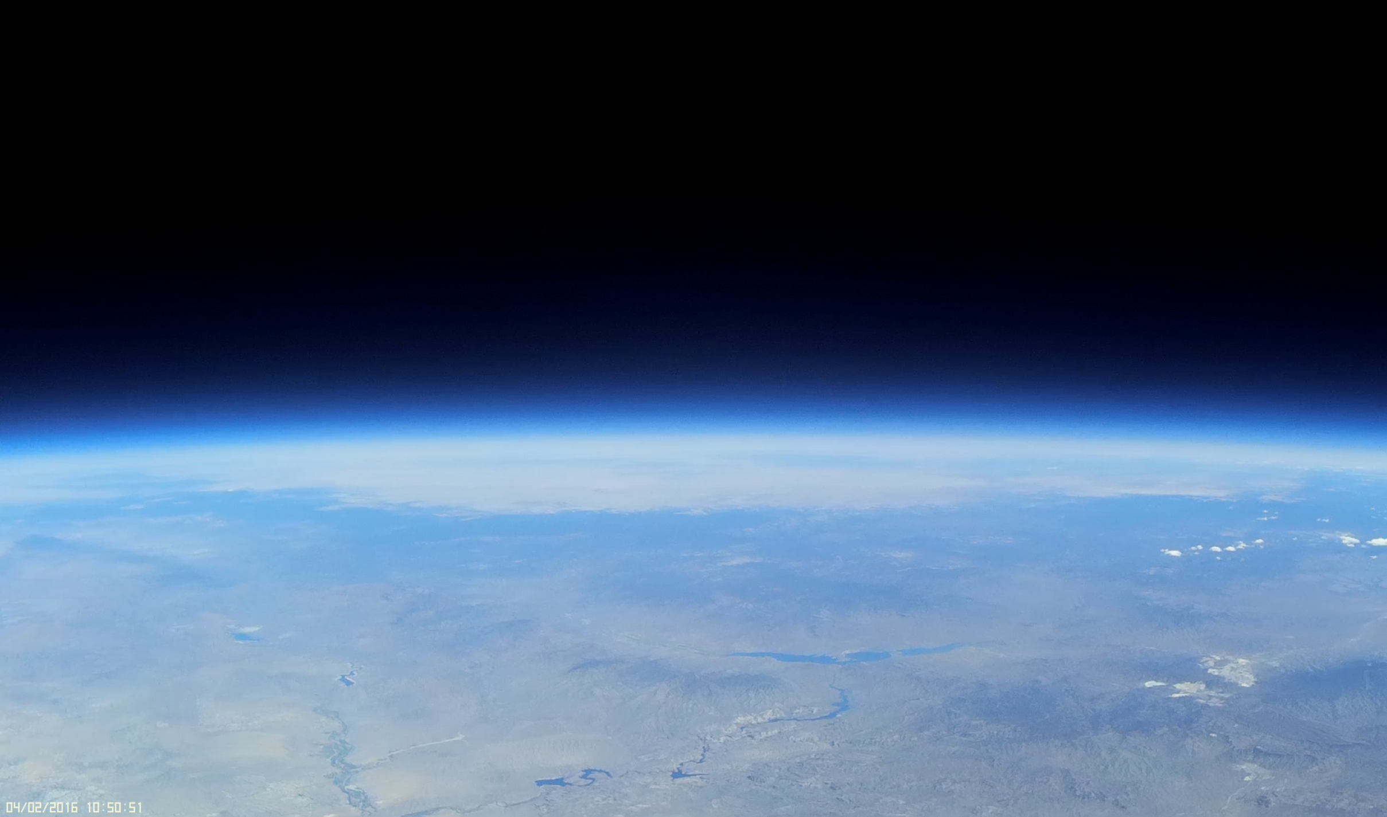
References
https://publiclab.org/wiki/infragram#cameras
http://www.ansr.org

